Slide 1

Scalable front-end
Architecture / 10-04-2024 / Gilliam Roelofs

Slide 2


A question
Why do “small” projects turn into chaos?
Notes:
Increased Complexity: As features are added, the project’s codebase can grow and become more complex. Without proper organization and architecture, this complexity can lead to spaghetti code, where everything is interdependent and difficult to modify or scale.
Maintenance: Over time, maintaining the code becomes challenging. Fixing bugs or adding new features can introduce unexpected issues in unrelated parts of the project, making it harder to maintain.
Team Collaboration: As more developers join a project, they may have difficulty understanding how everything fits together. If the project isn't modular or well-structured, it becomes harder for teams to collaborate without stepping on each other’s toes.
Performance Issues: If the app isn't designed to scale, performance can degrade as more users access the app or as the app handles more data. Load times can increase, and the user experience can suffer.

Slide 3
A question
How does an app scale from 100 to 100k users?
Notes:
Increased Server Load: As user numbers grow, the server load increases. This requires scalable backend infrastructure, but the frontend must also be designed to handle a larger number of requests and interactions efficiently.
Rendering and Performance: With more users, more data is rendered on the frontend, which can slow down the app if not optimized. Features like lazy loading, code splitting, and caching become crucial to maintain performance.
Scalability of Features: As the app grows, it will likely introduce new features. If the frontend isn’t modular, each new feature can make the code harder to manage and slower to load, leading to a poor user experience.
UX and Adaptation: More users means a broader spectrum of devices and network conditions to account for. The app must be adaptable, meaning it should be responsive and optimized for different devices

Slide 4
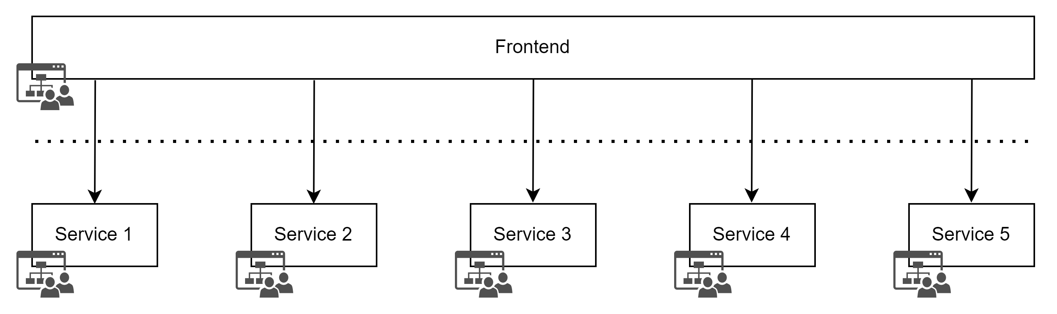

Why scalable frontend matters
Notes:
Classic approach: The monolithic app

Slide 5
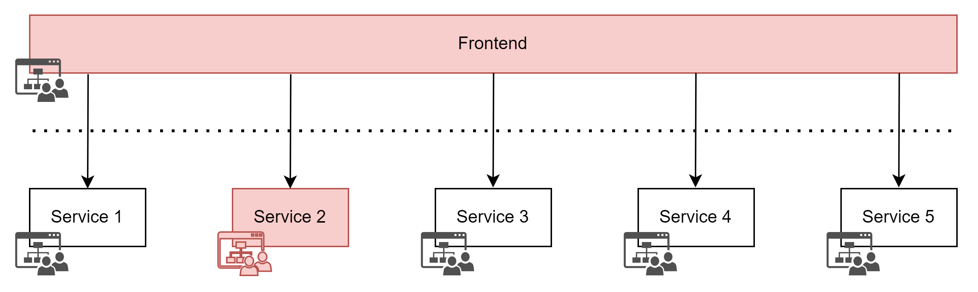
Why scalable frontend matters
Notes:
Classic approach: The monolithic app, a breaking change.

Slide 6
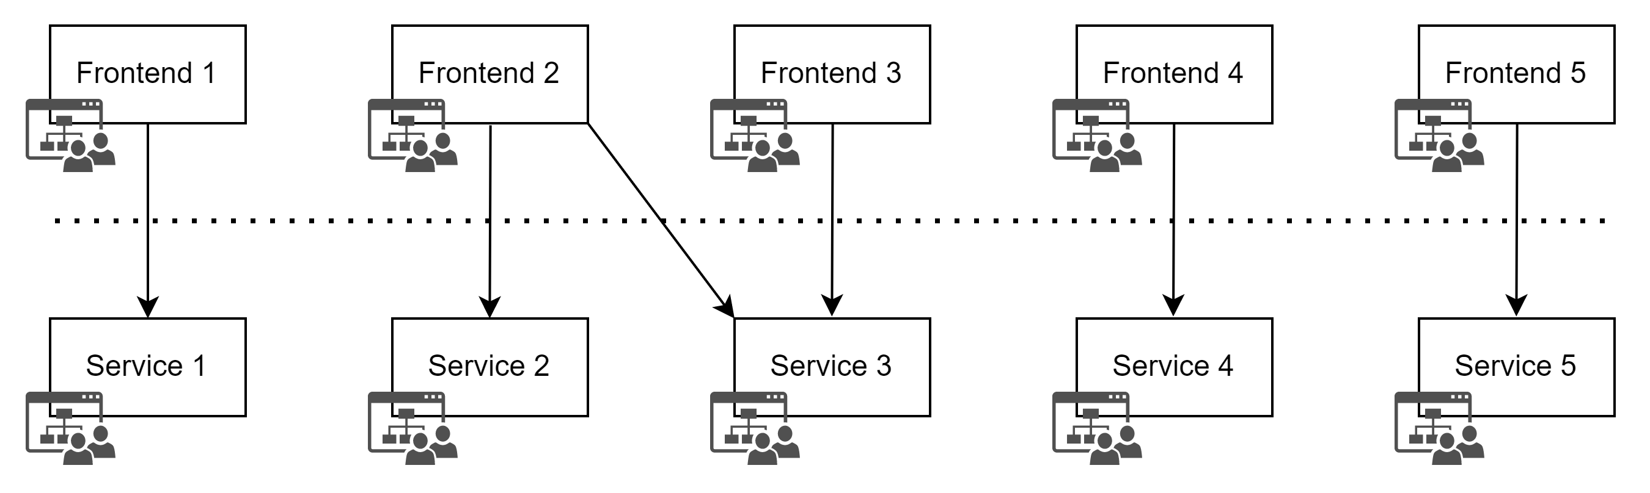
Why scalable frontend matters
Notes:
Multiple apps
Challenges: code sharing, multiple frameworks
Benefits: easy to understand, flexible technologies, different measurements on each frontend app depending on how critical each application for the business is.

Slide 7
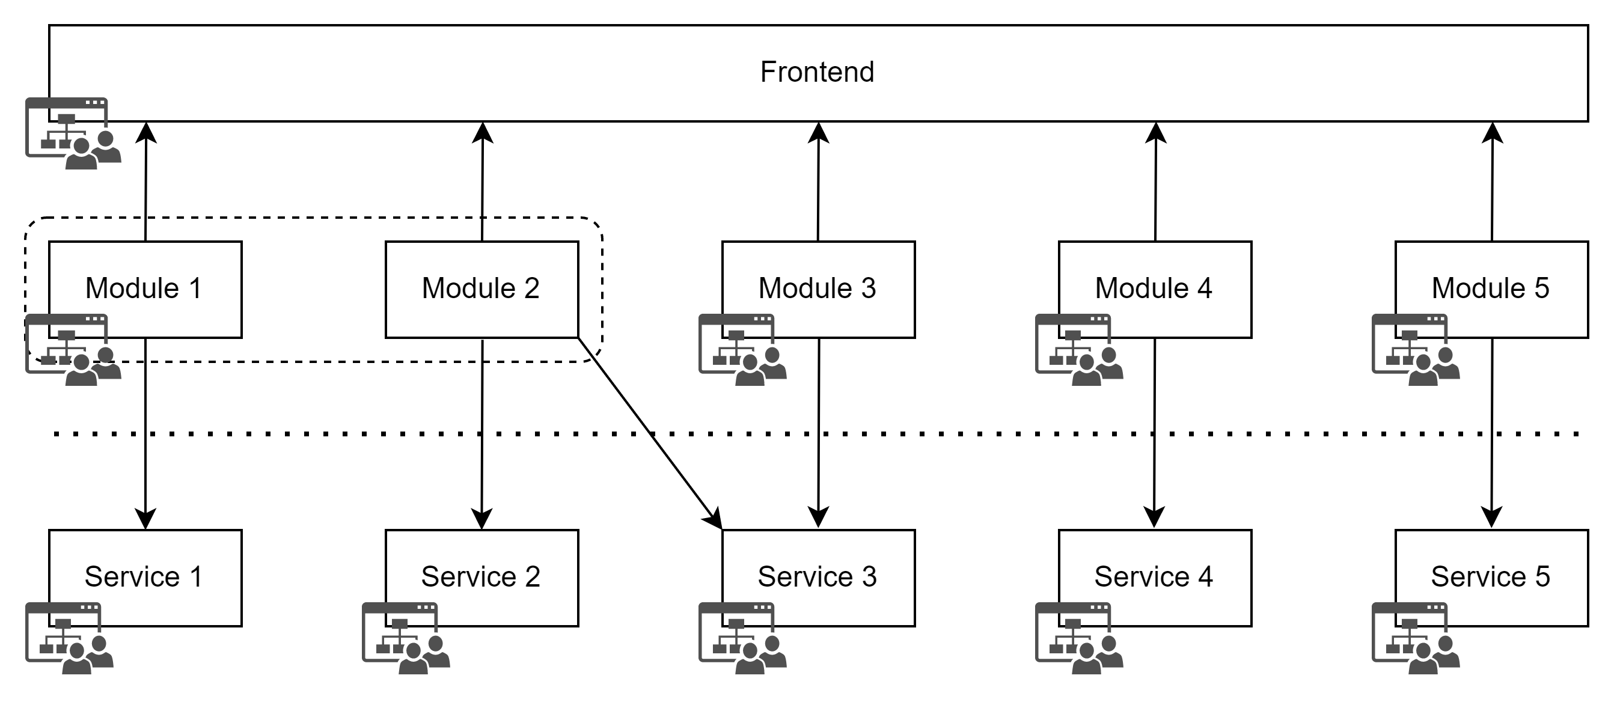
Why scalable frontend matters
Notes:
Micro-frontend approach
Challenges: Complex technical challenges, run time dependencies. Big investment in the “core” team. They do not deliver business value directly. They support your company.
Benefits: Flexible, highly adaptable, separate releases. As little download of resources as possible.

Slide 8
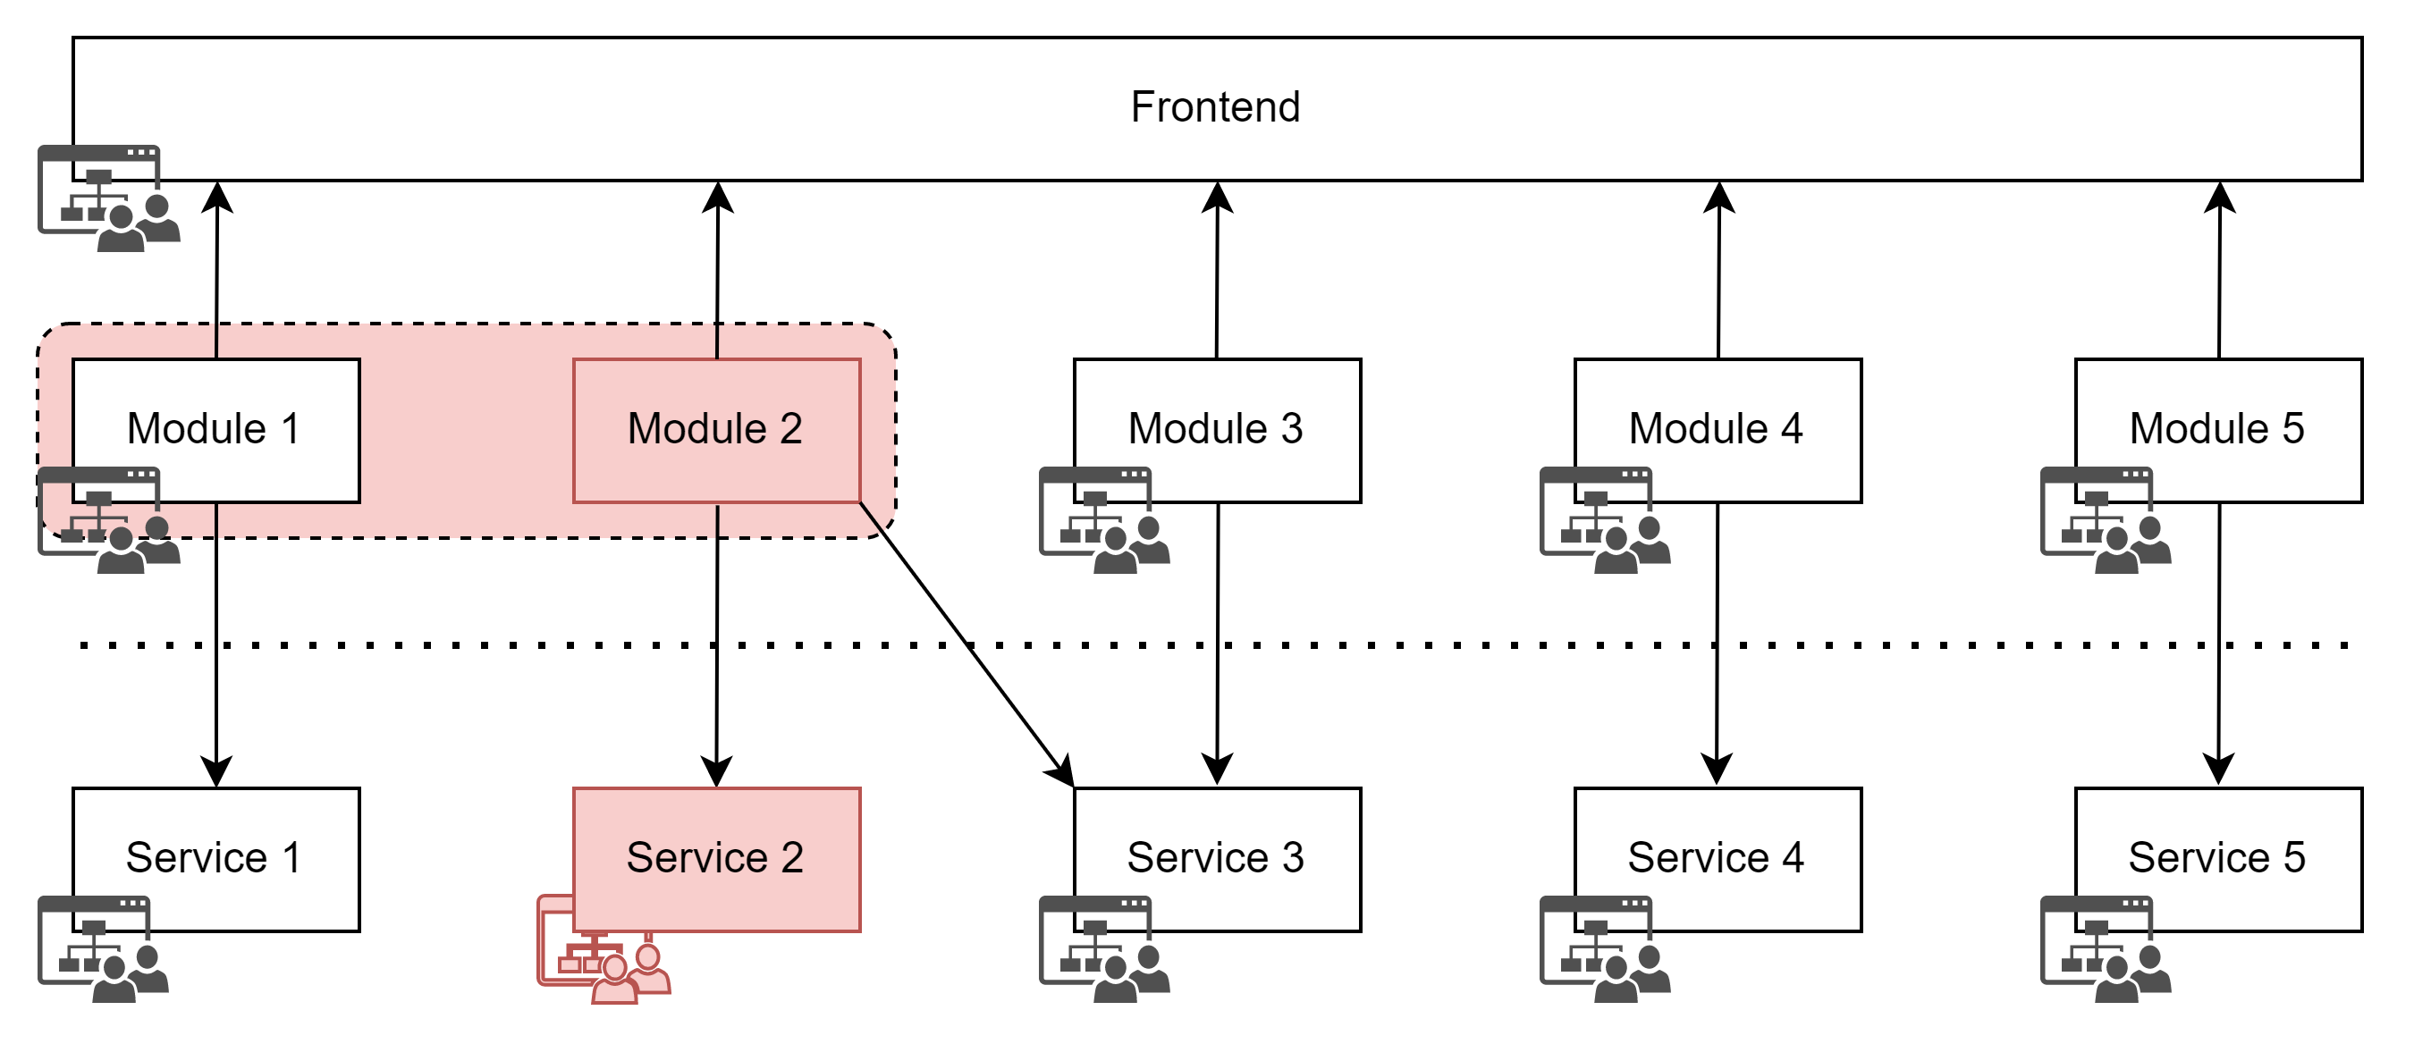
Why scalable frontend matters
Notes:
Micro frontend, a breaking change.

Slide 9


Concepts

Slide 10
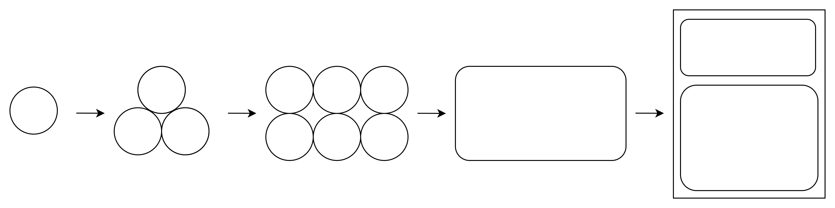
Atomic design
Notes:
Pro’s:
Offers modularity and organization
Enables scalability and adaptability
Extremely reusable
Encapsulates logic and loose coupling
Flexible design
Cons:
Risk of over-engineering
High maintenance

Slide 11
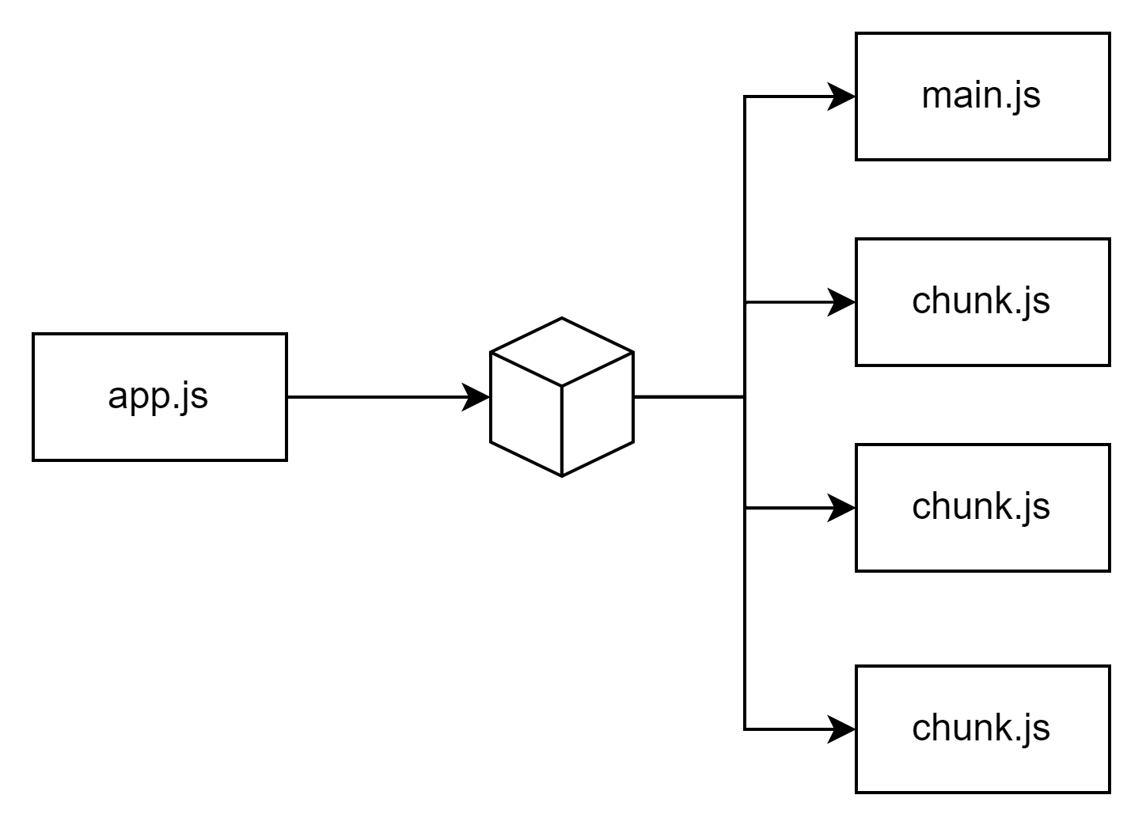
Code splitting
Notes:
Code splitting ensures that only the necessary parts of your application load initially, improving performance for large apps. Lazy loading allows components to be loaded as needed. Source: Webpack Documentation on Code Splitting.

Slide 12
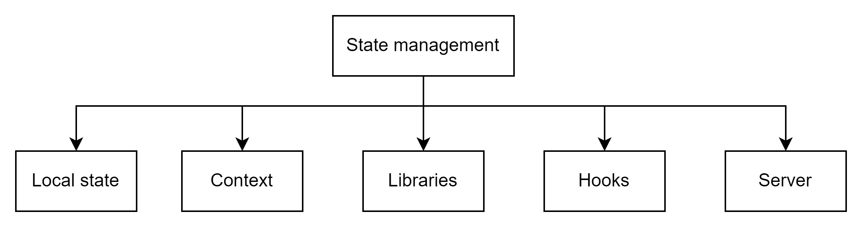
State
Notes:
State Management: Efficient state management is crucial in scalable frontend applications. Tools like Redux, Context API, and Recoil help manage state across large applications, ensuring performance and data consistency.

Slide 13
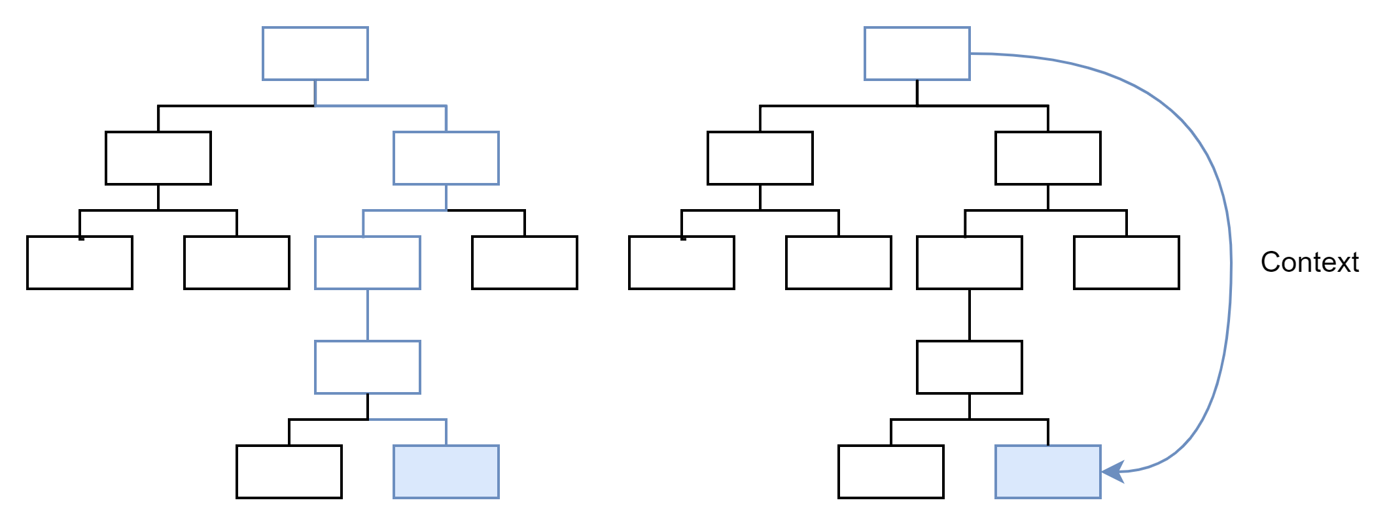
State in React components
Notes:
Left: Prop drilling (verbose and inconvenient)
Right: Context (increases cohesion)

Slide 14
Lets code
Notes:
Separation of Concerns: Breaking your project into different layers like presentation, logic, and state management is key to scalability. This makes it easier to update, extend, and test the project. Source: FreeCodeCamp on Separation of Concerns.
Component Libraries: Using component libraries such as Material UI, Chakra UI, or custom libraries allows for quick scalability by reusing pre-built, styled components.

Slide 15
Key takeaways
Structure: Feature-based folders and/or applications
Reusable: Focus on flexible, modular components
Code quality: Conventions, SOLID, KISS, DRY, YAGNY
Performance: Implementing lazy loading for faster load times

Slide 16
Organization

Slide 17
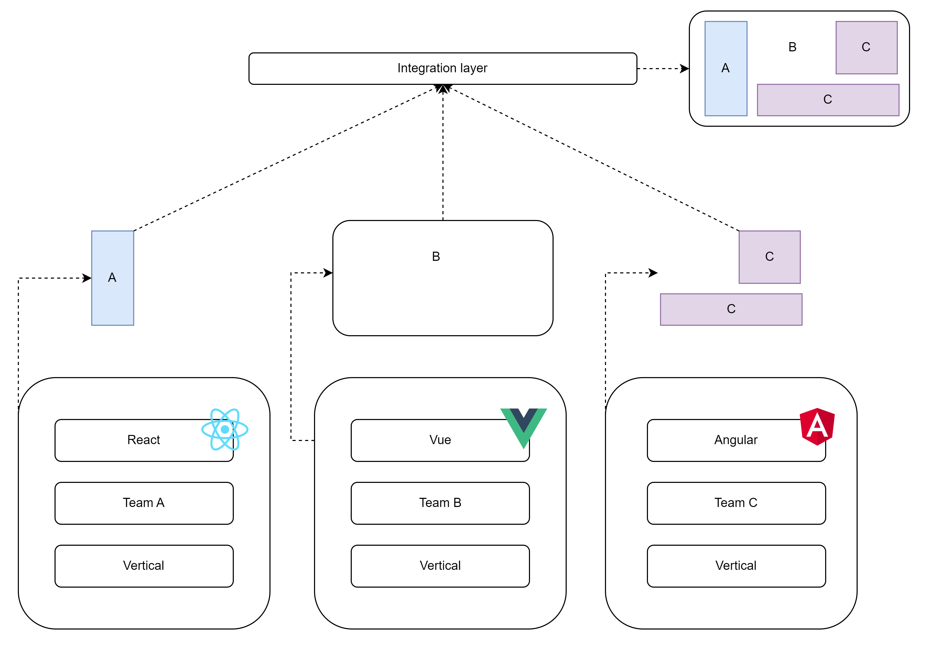
Micro front-end
Notes:
Cross-Functional Teams: Teams that include members with different skill sets (e.g., frontend developers, backend developers, designers, and QA engineers) help scale frontend architecture by working on distinct features or sections of the app in parallel. Source: Atlassian on Cross-Functional Teams.
DevOps and Continuous Integration: Implementing a CI/CD pipeline for the frontend helps teams scale by automating builds, testing, and deployments. This ensures that new features can be released quickly without compromising the existing system's stability. Source: DevOps.com on CI/CD.

Slide 18
Q/A

Slide 19
Design systems
https://www.figma.com/design-systems/
Atomic design
Design tokens
Design system adoption
Checkout https://storybook.js.org/
Do not introduce if the business is not prepared to invest.
Notes:
Read more about adoption: https://uxplanet.org/design-system-adoption-1adc90e87119
Examples:
https://m3.material.io/
https://carbondesignsystem.com/

Slide 20

SEO
https://developers.google.com/search/docs/fundamentals/seo-starter-guide
https://web.dev/articles/vitals
https://developers.google.com/search/docs/crawling-indexing

Slide 21
European Accessibility Act 2025
https://business.gov.nl/amendment/european-accessibility-act-products-services/
WCAG AA compliance
https://www.w3.org/TR/WCAG21/
Google Lighthouse or axe DevTools

Slide 22
Code patterns
https://www.patterns.dev/
Observer pattern
Module pattern
Dynamic Import
And more ☺

